Slide 1
Prototyping for Tangible and Physical Computing

Slide 2
Background

Slide 3
Direct Manipulation
Coined by Ben Shneiderman (1982)
A replacement for complex command syntax
Continuous representation of the object of interest
Physical actions or button presses
Rapid and reversible operations whose impact is immediately visible
Notes:
Challenge in finding obvious physical models: suggests a rolodex, check boxes, and card catalogue.

Slide 4
Event Handling
function DoSomething(e) {
var letter = e.key;
document.getElementById("display").innerHTML = letter;
}
window.onload = function() {
window.onkeypress = DoSomething;
}

Slide 5
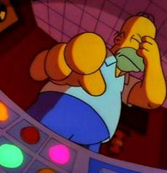
On Keypress…
function DoSomething(e) {
var letter = e.key;
document.getElementById("display").innerHTML = letter;
}
window.onload = function() {
window.onkeypress = DoSomething;
}

Slide 6
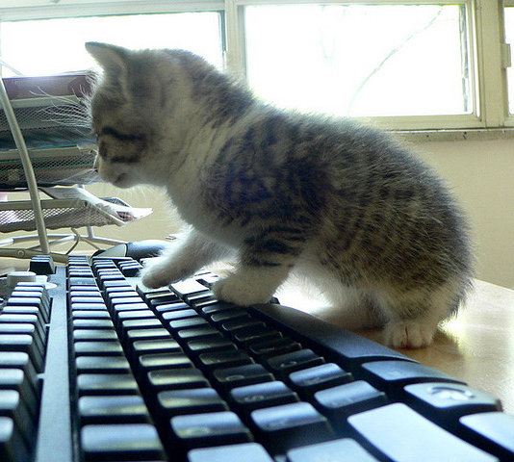
On Keypress…
function DoSomething(e) {
var letter = e.key;
document.getElementById("display").innerHTML = letter;
}
window.onload = function() {
window.onkeypress = DoSomething;
}

Slide 7
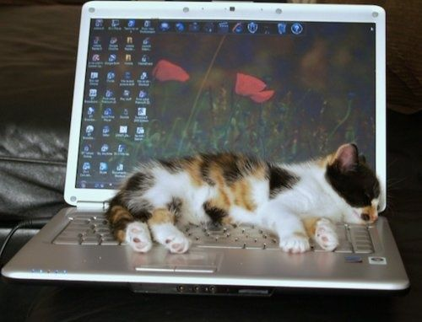
The more likely story…

Slide 8
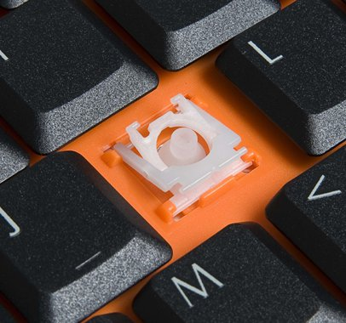

Event Handling Assumes Some Things about Users….
What is a click?
A change in state of a button.

Slide 9

“How the computer sees us.”

Slide 10
“When compared to other human operated machinery (such as the automobile), today’s computer systems make extremely poor use of the potential of the human's sensory and motor systems. The controls on the average user's shower are probably better human-engineered than those of the computer on which far more time is spent.”
-Bill Buxton

Slide 11
How Bodies Matter
Thinking through doing
Performance
Visibility
Risk
Thick Practice
Notes:
Embodied cognition tells us that a key component of cognitive development occurs through direct interaction with the world.
Expertise is characterized as acting through an artifact rather than on it.
The artifacts generated through coordinated practice such as in the workplace provide visibility to the state of collaborative activities.
Physical action is characterized by risk as a person has to make a commitment to their choice and bear the consequences.
Finally, technology as a project sets out to create increasingly malleable materials that risk displacing the real world in an effort to model it. This does away with rich, integrated practices that people have evolved over substantial periods of time.

Slide 12
Tangible Computing

Slide 13
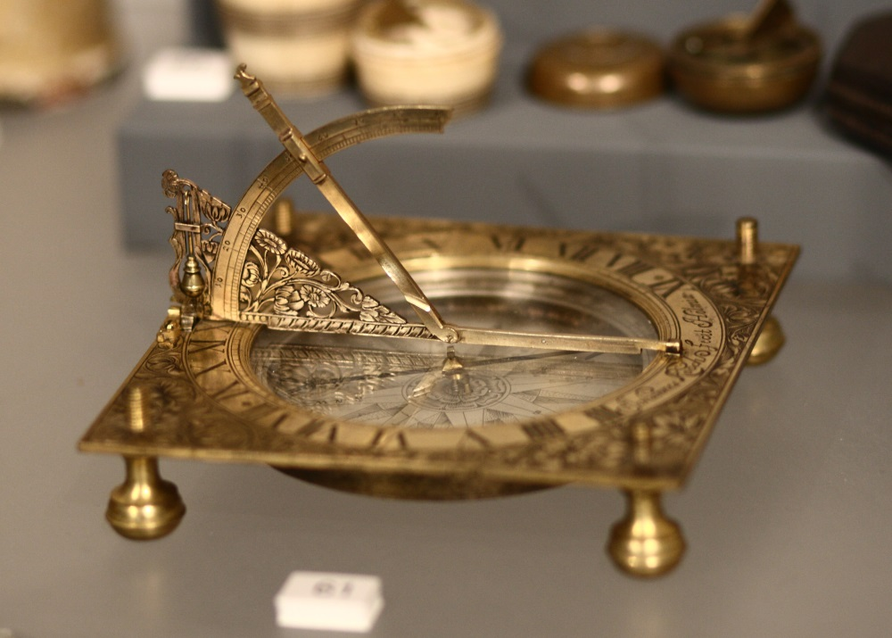
Tangible Bits Critique
No seamless coupling between virtual and physical objects
Hasn’t always been the case
Grasping and manipulating

Slide 14
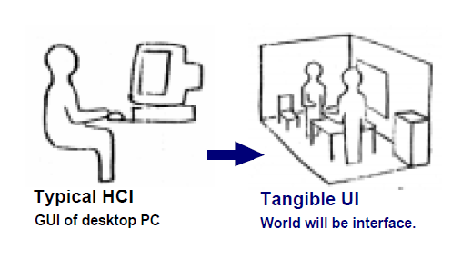
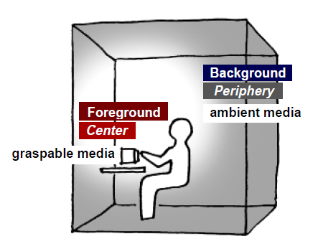
Turn physical matter into an interface

Slide 15
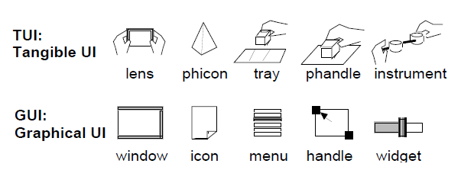

Slide 16


Example Projects
Attention
Periphery

Slide 17
What is Physical Computing?

Slide 18
Challenges for Prototyping

Slide 19
Detecting Use

Slide 20
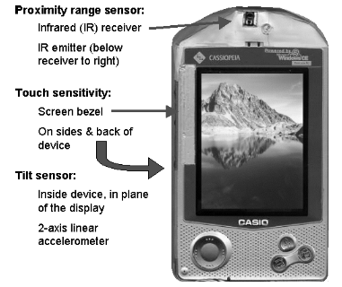
Sensors

Slide 21
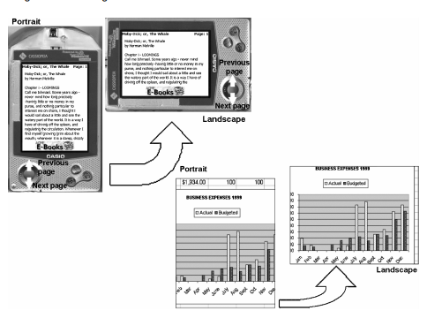
Interaction Techniques
Microphone gesture for voice recording
Tilt detection for display mode
Bezel scrolling
Power off
Sensing Demo

Slide 22
Rapid Iteration

Slide 23
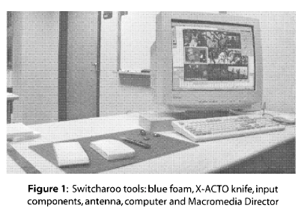
Switcharoo focuses on Input/Output

Slide 24
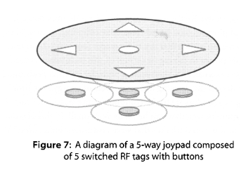
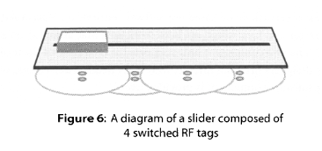
Sketching with Switches (Tracking State)

Slide 25
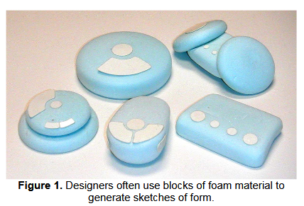
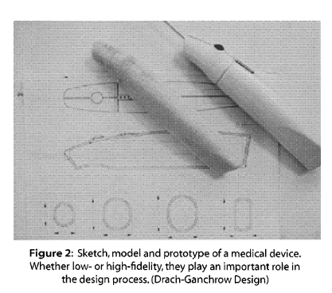
Foam Modelling
Notes:
3D sketches in a 3D modelling tool used to create foam models

Slide 26
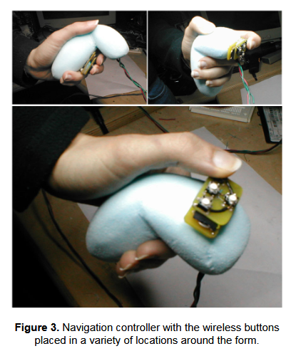
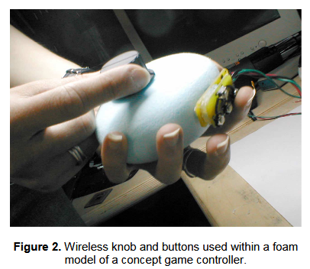
Mid-level Fidelity

Slide 27
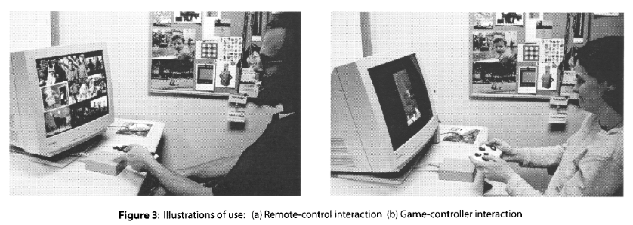
Video Shorts used to Display Output/Feedback
Notes:
Unique IDs were sent to a Java Server to retrieve relevant video data as feedback

Slide 28
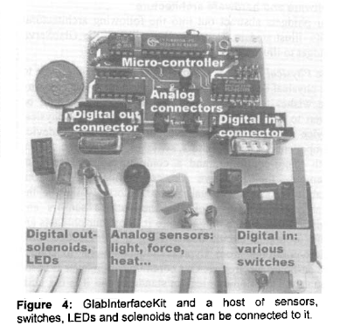
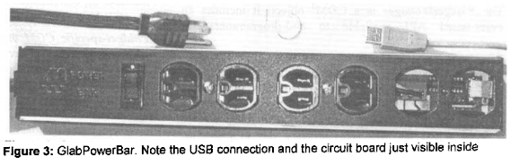
Physical Widgets (Phidgets) Instead of Physical Icons (Phicons)

Slide 29
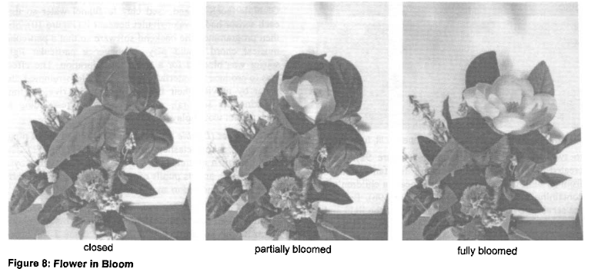
Interface Building with Modularity

Slide 30
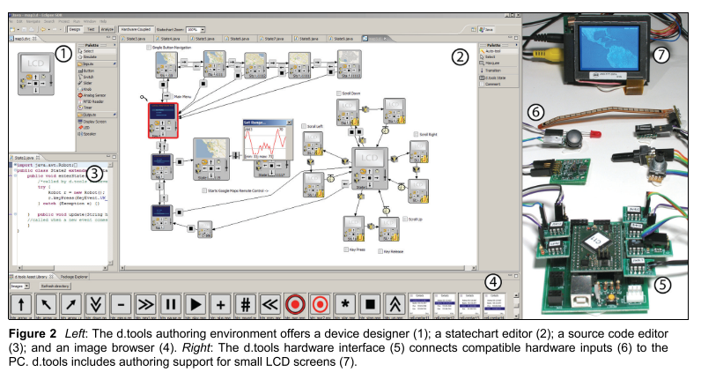
Rapid Testing and Feedback
Notes:
Extends storyboar idea to state chart diagram, modular physical prototy[ing with pluggable moducles, video recording of interaction with device and automated event capture

Slide 31
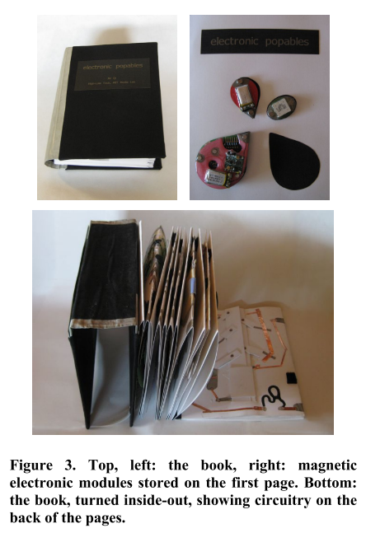
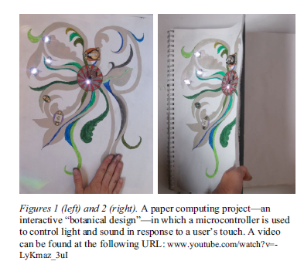
Computational Sketchbook
Sketching Circuits
Binding Traces

Slide 32
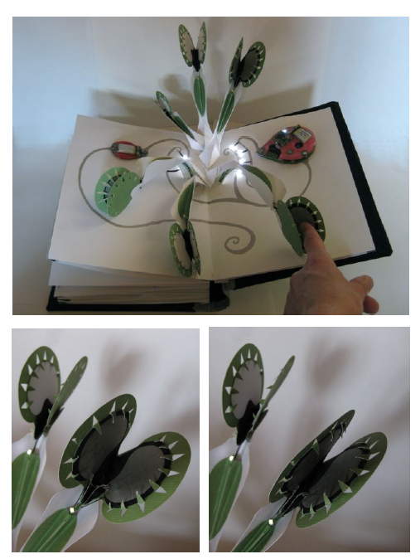
Adding Interactivity to Paper
Touch sensors
Bend sensors
Buttons
Lights
Sound
Etc.
Video

Slide 33
Form and Interactivity

Slide 34
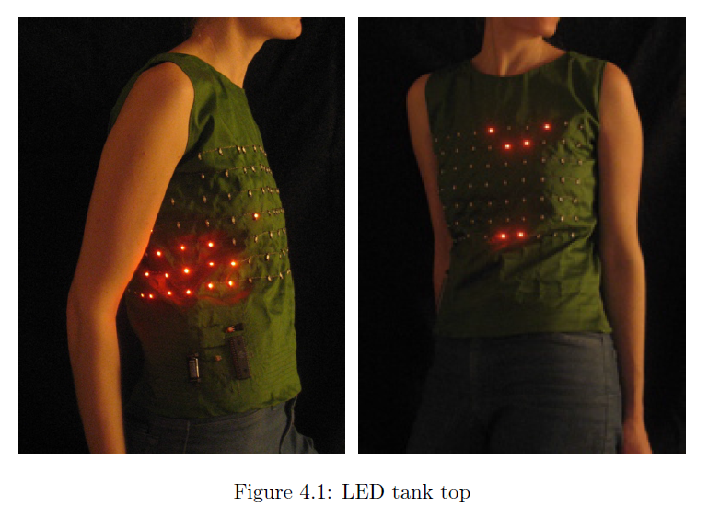
Form Factor Impacts Personalization and Self-expression

Slide 35
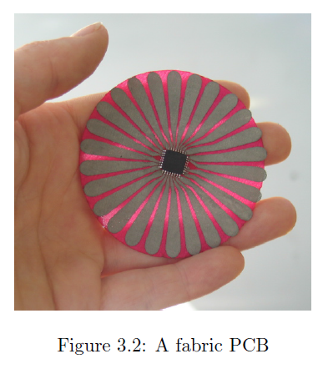
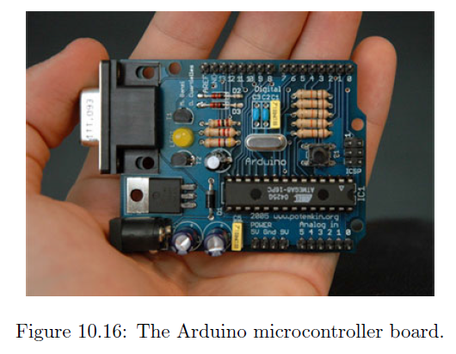
Implications for PCB Design
Soft PCB
Typical PCB

Slide 36
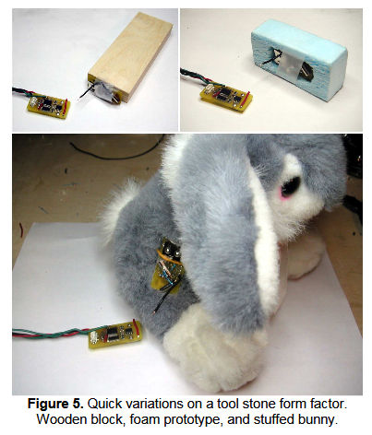
Quick Experimentation with Form
Attaching sensors to generic form, foam mold, and existing form

Slide 37
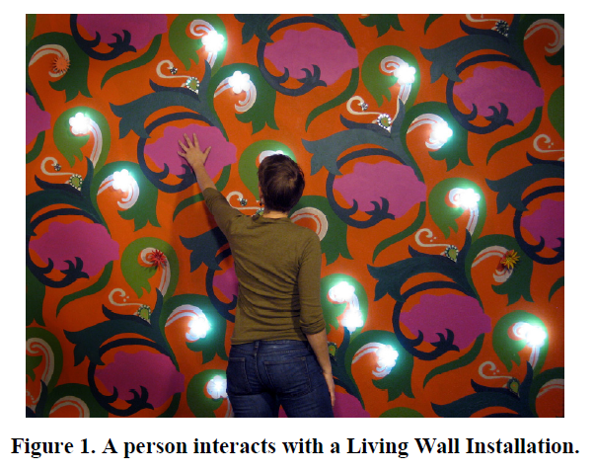
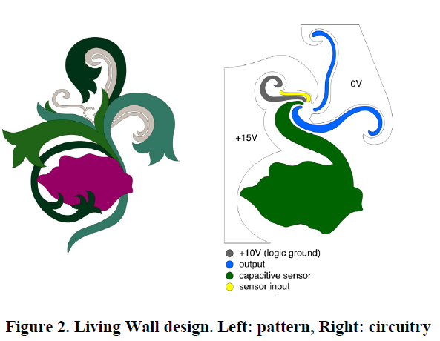
Room Decor
Wall Paper
Circuit Design

Slide 38
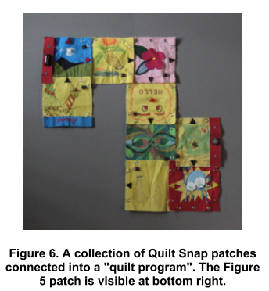
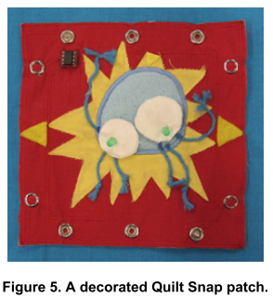
Tangibility and Seamfulness Helpful for Learning Programming
Modular Programming
Composition

Slide 39
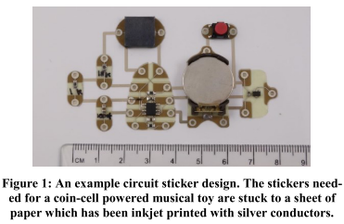
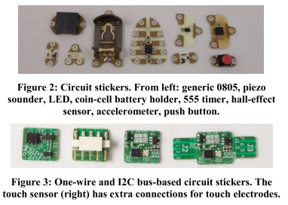
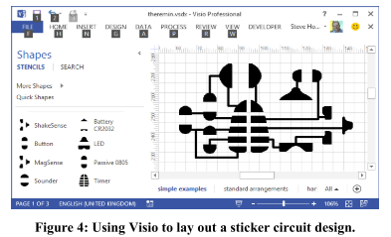
Learning Circuitry

Slide 40
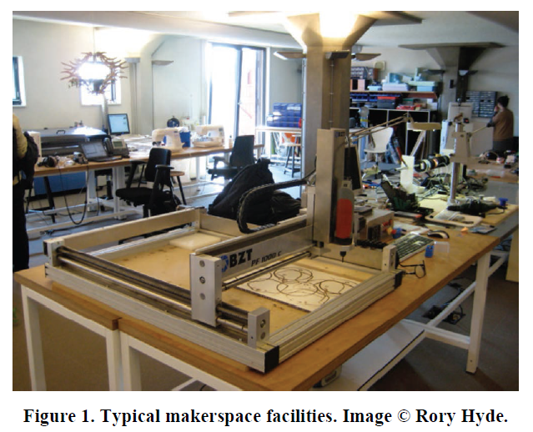
DIY and Tech Democratization

Slide 41
Craft and Electronics

Slide 42
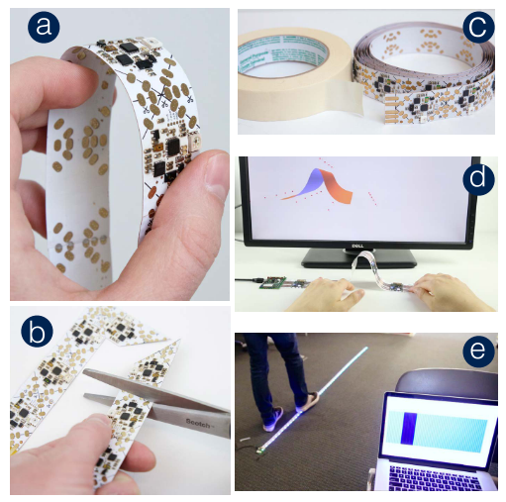
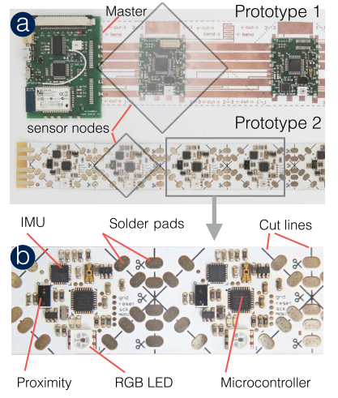
Cuttable Like Tape

Slide 43
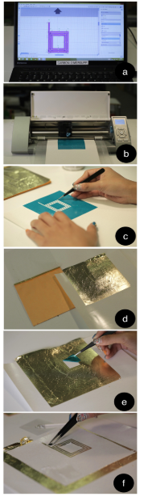
Drawing with Stencils

Slide 44
Fabricating Electronics

Slide 45
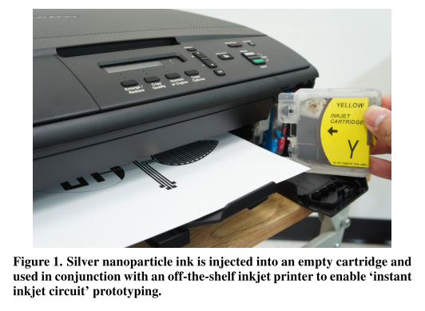
Printable Circuitry

Slide 46
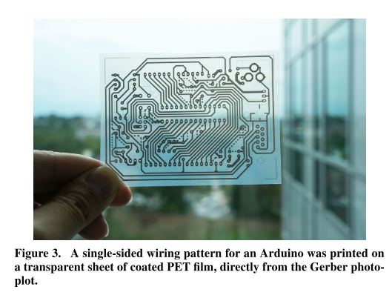
Printable Circuitry

Slide 47
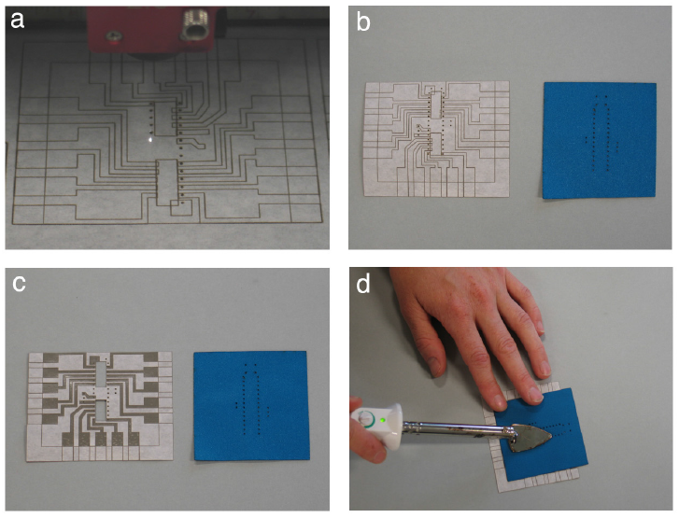
Iron-on PCB

Slide 48
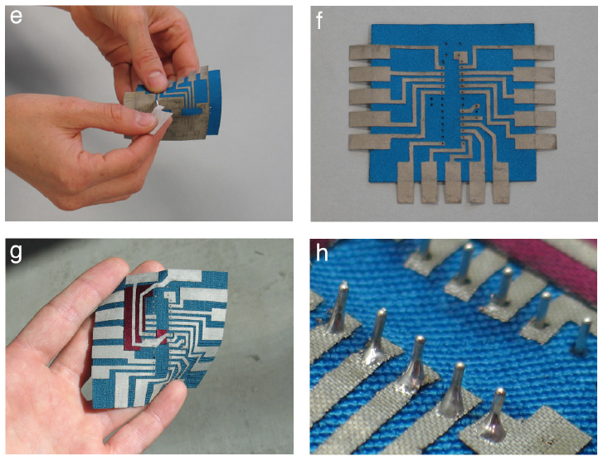
Iron-on PCB

Slide 49
Fabrication

Slide 50
2D to 3D

Slide 51
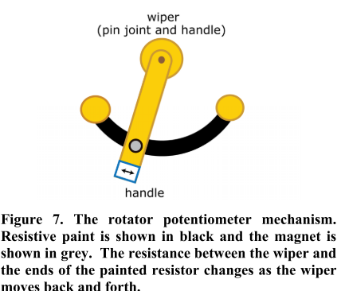
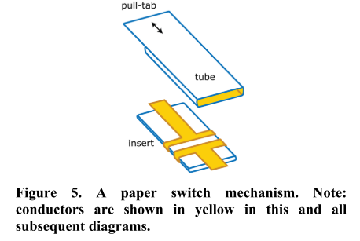
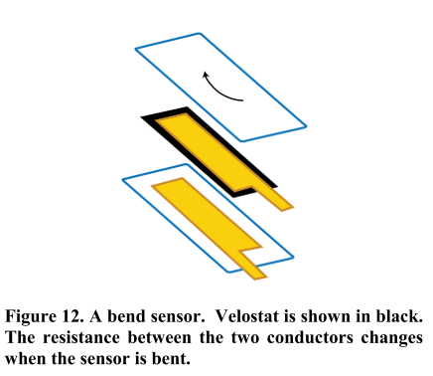
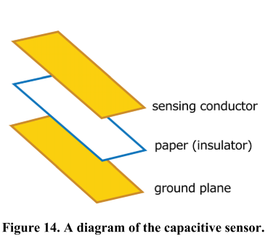
Pop-ups and 2.5D

Slide 52
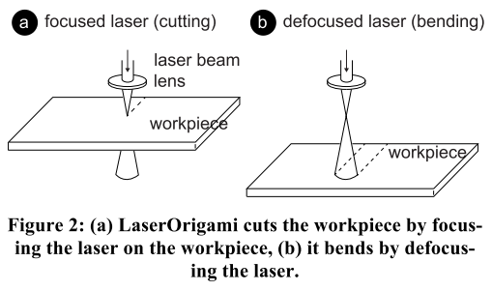
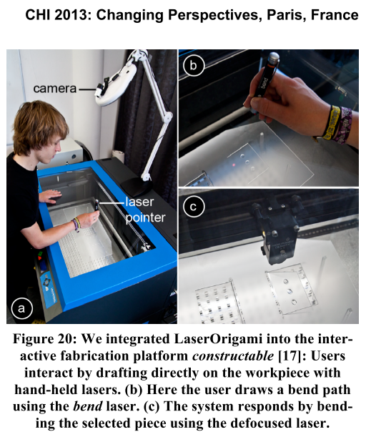

Laser Cutter and 2.5D
Defocused Laser
Freehand Drawing

Slide 53




Stacked, Cut, and Melted for 2.5D

Slide 54
Modelling Form

Slide 55

Wireprinting

